Slide 1

InMoov : Interactive Robot
innovative project
Il faut trouver une belle image

Slide 2
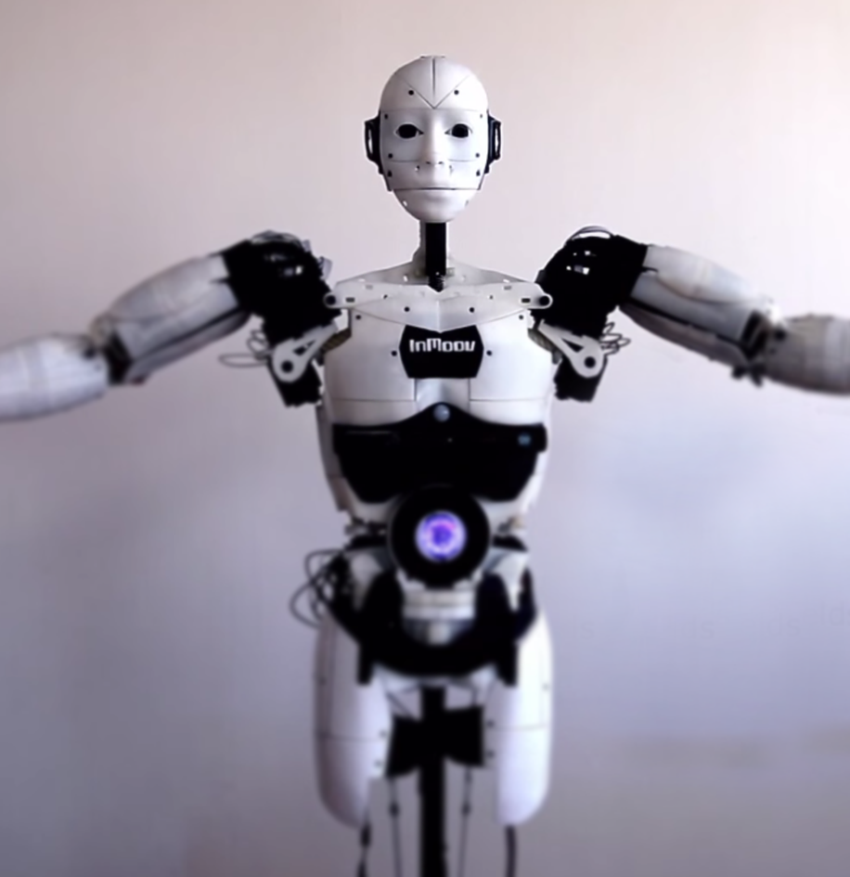


OUR INMOOV PROJECT
What is InMoov ?
Open Source 3D printed life-size robot designed by Gaël Langevin. Worldwide spread community with 3600 members.
MyRobotLab
Open source Java based framework for robotics used to launch python scripts to control the InMoov robot.
How does he communicate ?
The conversation engine inside the official InMoov robot is the AIML.
Basically it is a form of XML that encodes rules for questions and answers.
Our Innovation
With AIML it is difficult to scale if patterns are manually built.
Our goal : Allow our robot to answer a question without needing us to teach him this specific question.

Slide 3




Initial Skills
Using previously acquired knowledge in the Inmoov project
Robotic
3D Printing
Participation in the national robotic tournament with the Association of Robotics called DaVinci Bot.
Experience in modelling specific mechanical objects and printing them with 3D printers.
Mastered areas of expertise
Python
Project Management
Popular object oriented programming language often used in Machine Learning.
Use of soft skills: planning, decision making, creative work and team spirit.

Slide 4
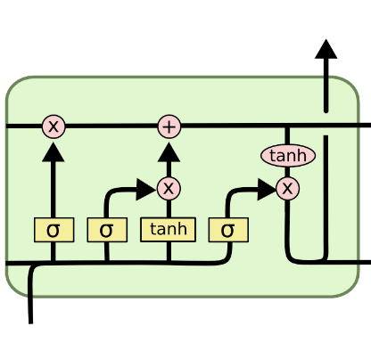




Compétences
AI Master Class
Action
Response
Deep Learning

Slide 5

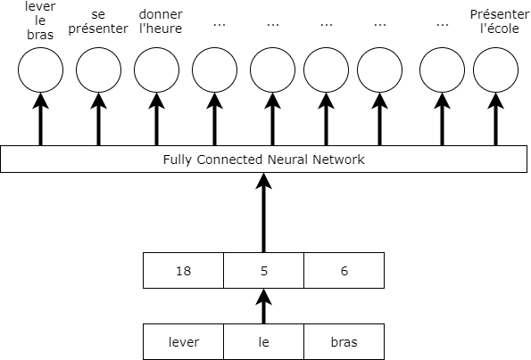
Inefficiency
Réseaux de neurones incompétent in english

Slide 6


Technology Use
Snips :
Use Artificial Intelligence
Allows you to build powerful voice assistans
Provides a neural networks
Multi-Platform : Raspberry Pi 3, Android, Linux
Protect our privacy
Easy to use
Set up :
Build an assistant
Create bundles and intent
Train the model
Set up Snips on our Raspberry Pi 3
Mettre un gif montrant le bundle avec les intents

Slide 7
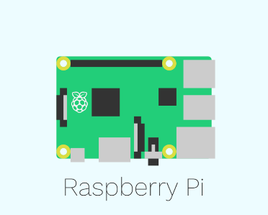


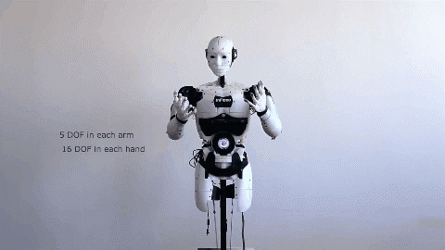
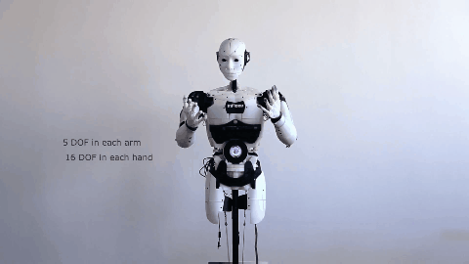
Technical Solution
Speech recognition
Output :
Intent generated
Sending data (TCP)
Handler
MQTT Connection
Recover the Intent
- Send the Intent to MyRobotLab Using TCP communication

Slide 8


What’s left to do ?
1
To achieve our goal
2
Continue developing our voice assistant to achieve better results.
3
Create a Python algorithm to bind an action to the result of the snips API.

Slide 9
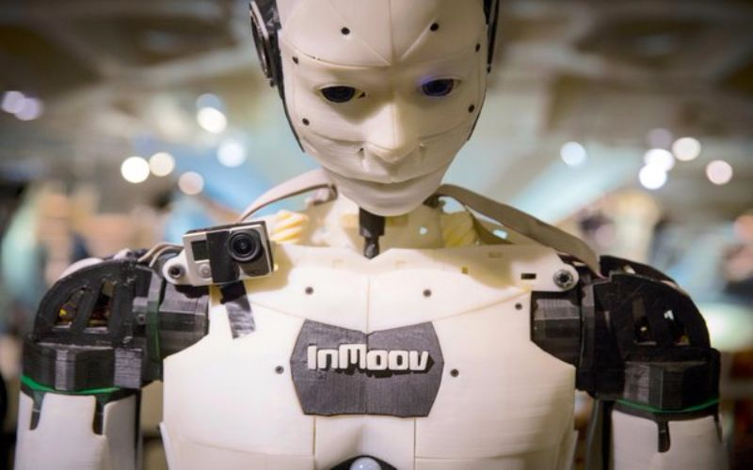
Thank you for your attention

